Slide 1
PROGRAM MANAGER’S REPORT Formerly Utilized Sites Remedial Action Program St. Louis Sites
Prepared by Bruce Munholand
For Open House Information Meeting
February 28, 2019

Slide 2
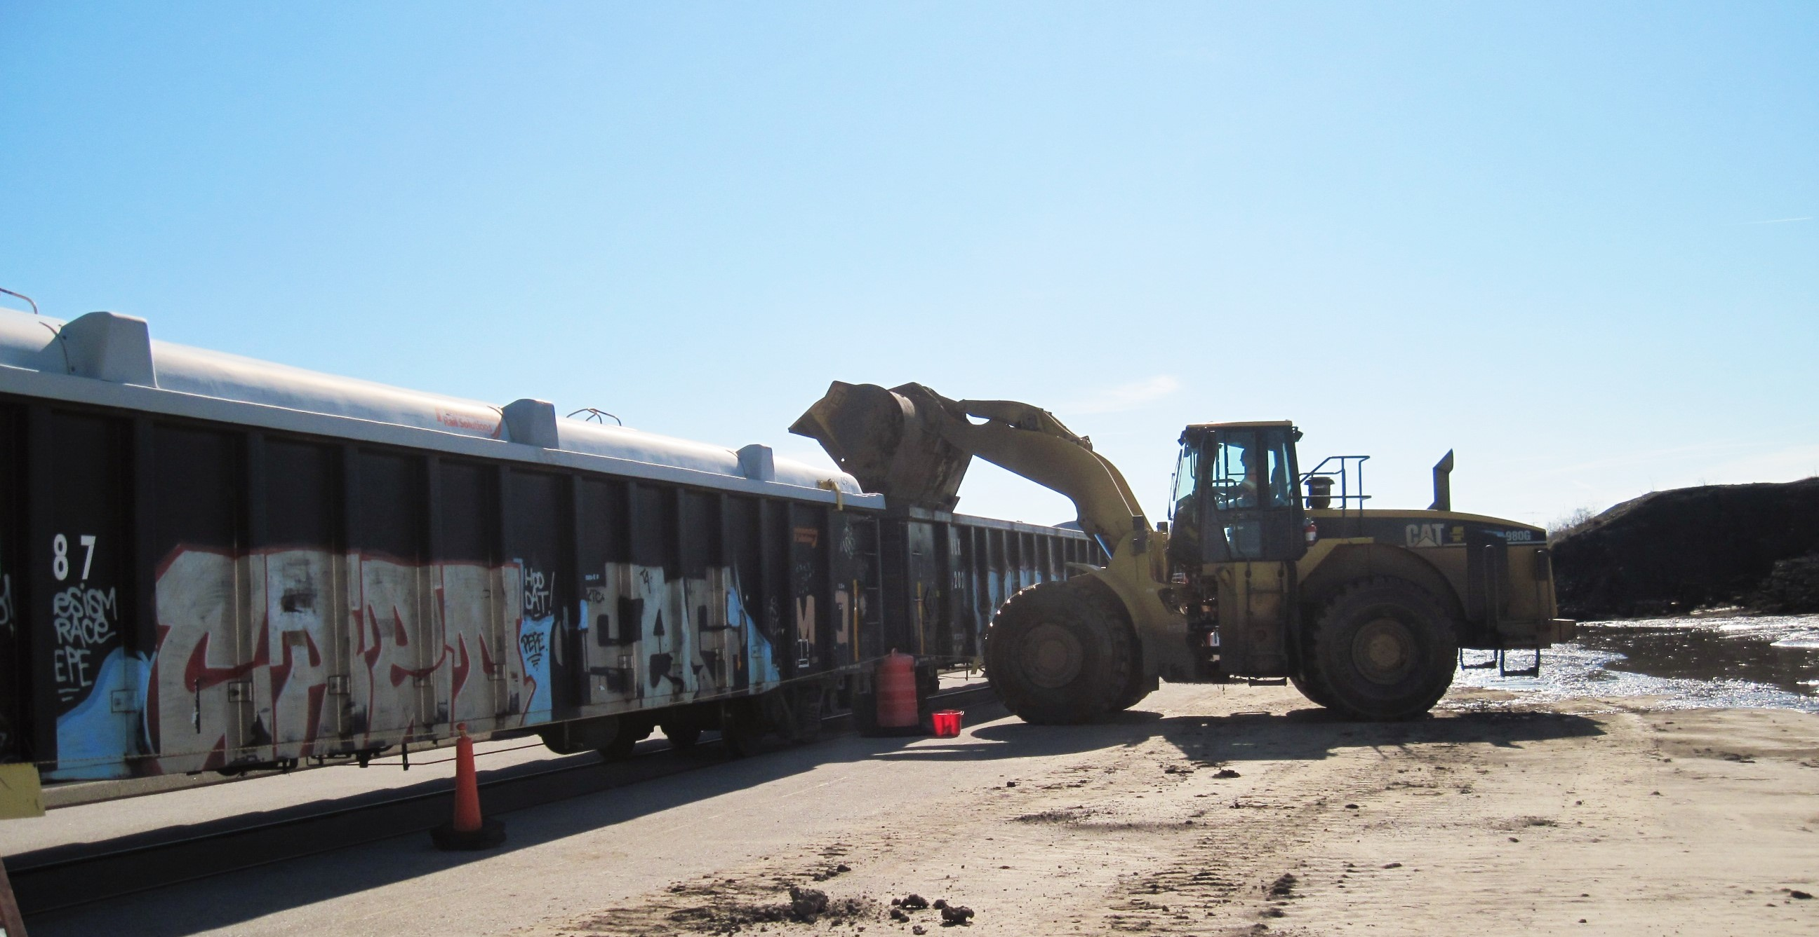
Shipping & Disposal History
(Cubic Yards of Low-level Radiologically Contaminated Soil)
Project Site FY2018 Actual FY2019 Planned
SLAPS Vicinity Properties 18,516 18,000
Latty Avenue Properties 0 150
St. Louis Downtown Site 12,872 7,000
TOTAL (Cubic Yards) 31,388 25,150
~ 375 Railroad Cars
Planned in 2018
28,000 CY
Notes:
Will discuss more a little later, but:
SLAPS and HISS are source locations: already complete so shows 0 CY
Latty Properties deferred while we focus on CWC properties; Includes the HISS source site which is already cleaned up
IAAAP will actually process close to 13,000 CY to get 1,300 CY shipping

Slide 3
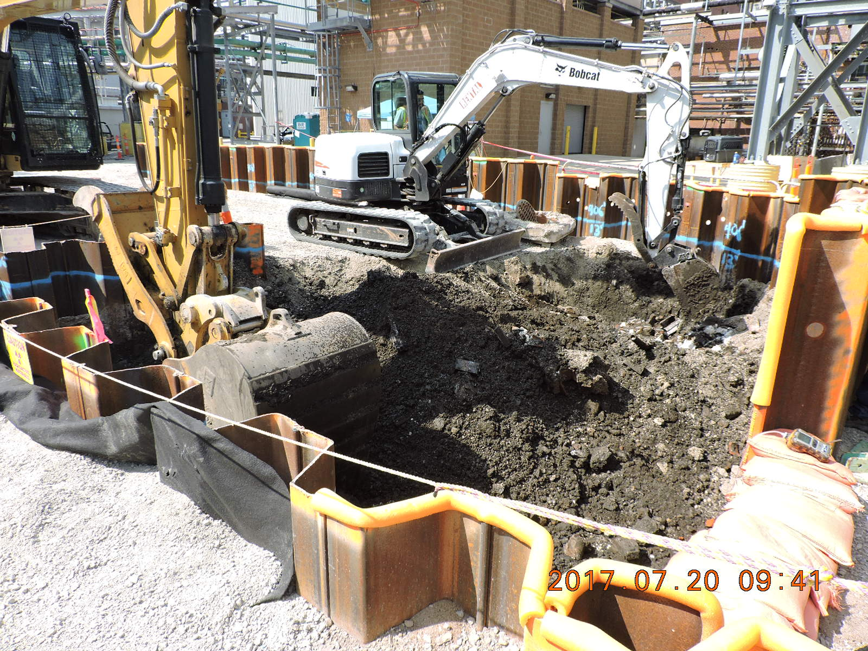
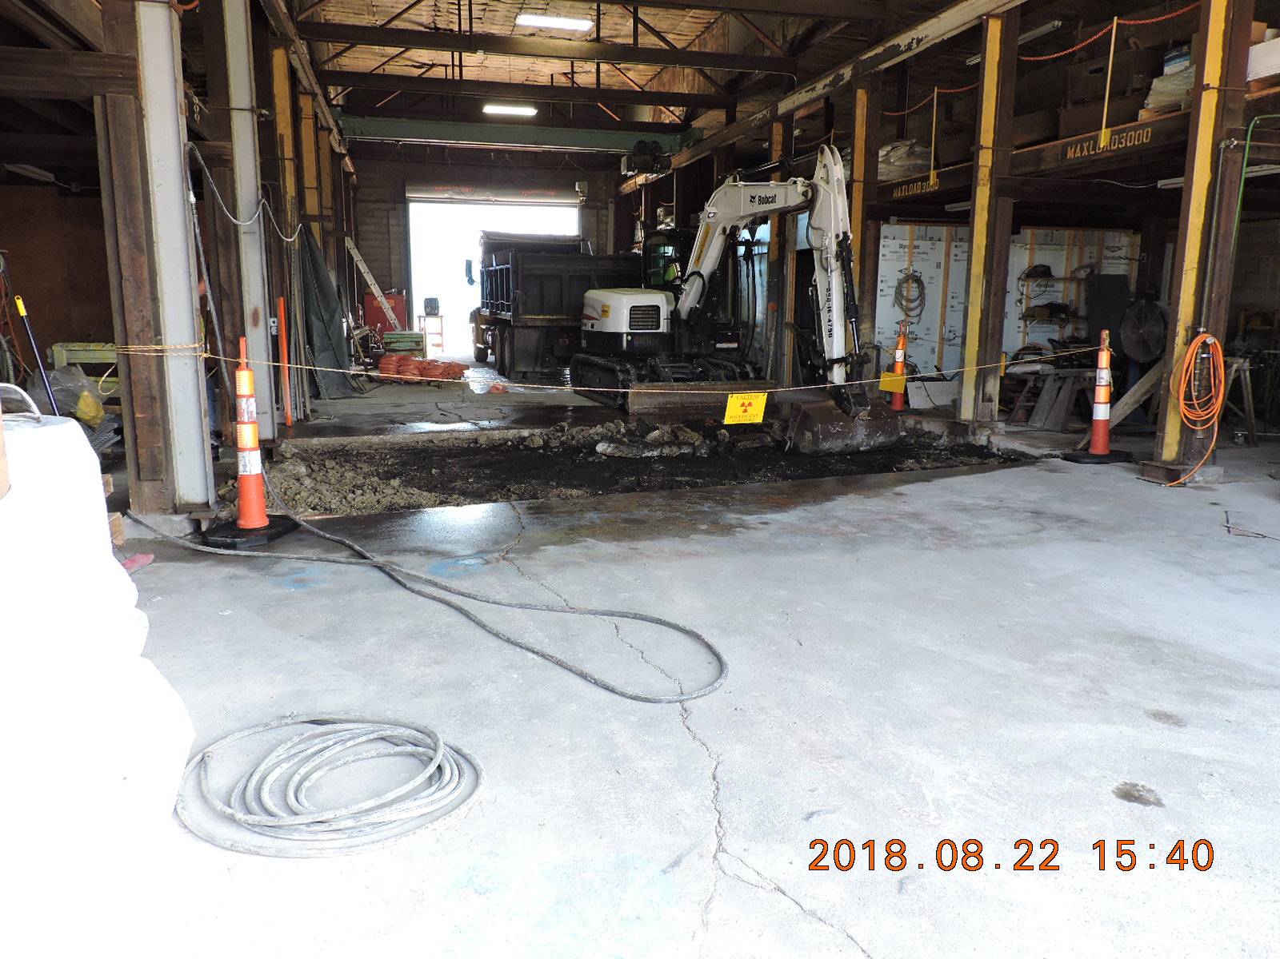
Downtown Site Remediation
(2018)
Former Building 17 Area Remediation
The downtown site contains many businesses and structures within a tight area, some of which were constructed over historical areas of contaminated soil.
There is extensive use of sheet-pile walls for below-grade work, a myriad of utility concerns, and work inside operational facilities requiring continual property owner coordination.
Property DT-6 Remediation
Destrehan Street Remediation
Notes:
St. Cin: weather permitting parking lot will be repaved tomorrow
Duchesne Park has a north and south site; north site is complete and property will soon be returned for Beneficial Use.
COCs being found at depths up to 4-8 ft.
Current estimate is 50% - 60% complete.
Next sites:
1. desire to do Palm Drive Props next; dependent on timing of when utility work is done;
2. Archdiocese next if follow-on bounding work is completed timely
3. Third option is to move to Ballfields
Desire to open multiple sites: funding and sampling dependent

Slide 4
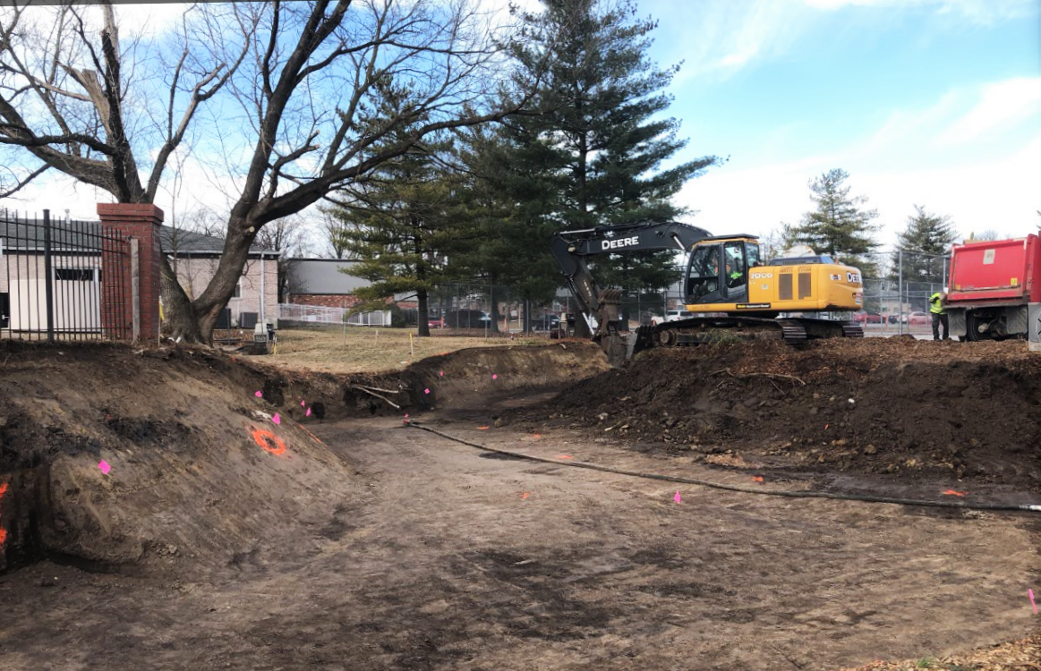
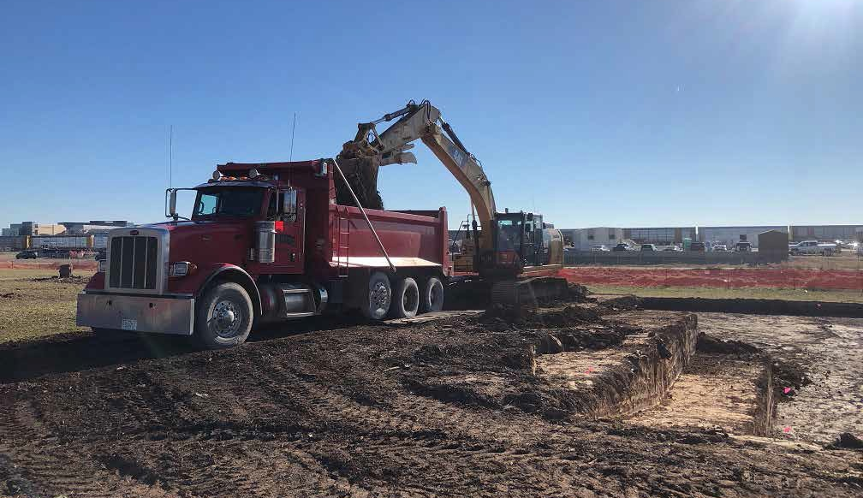
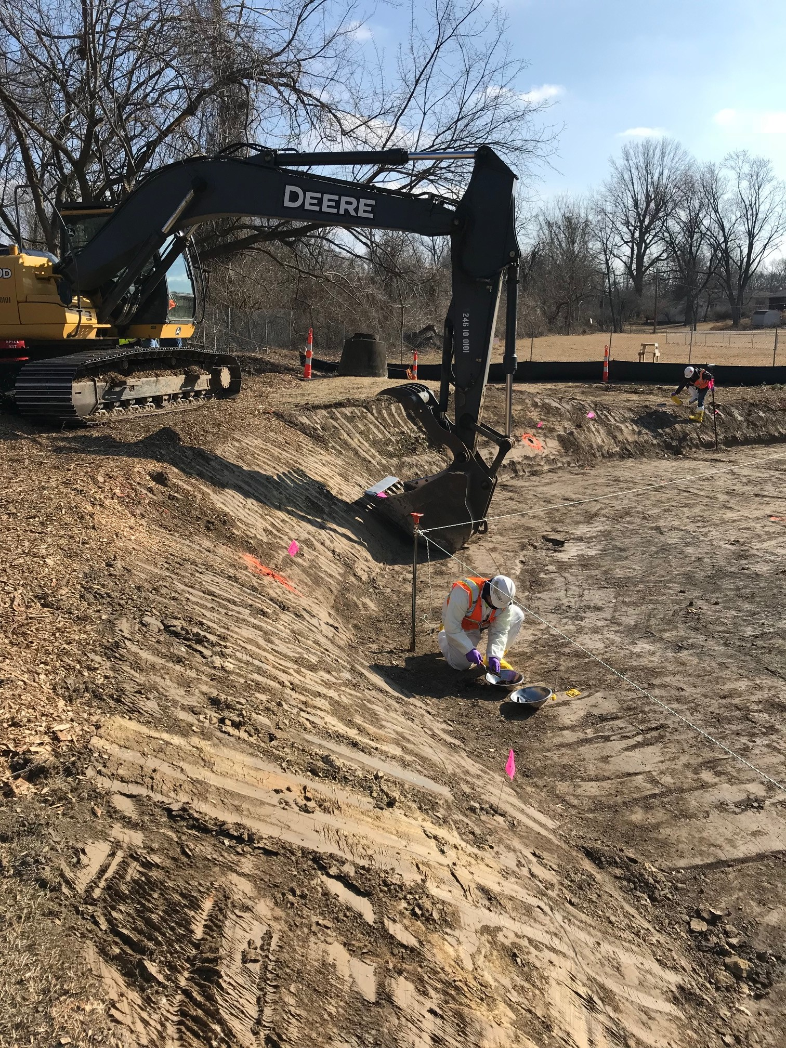
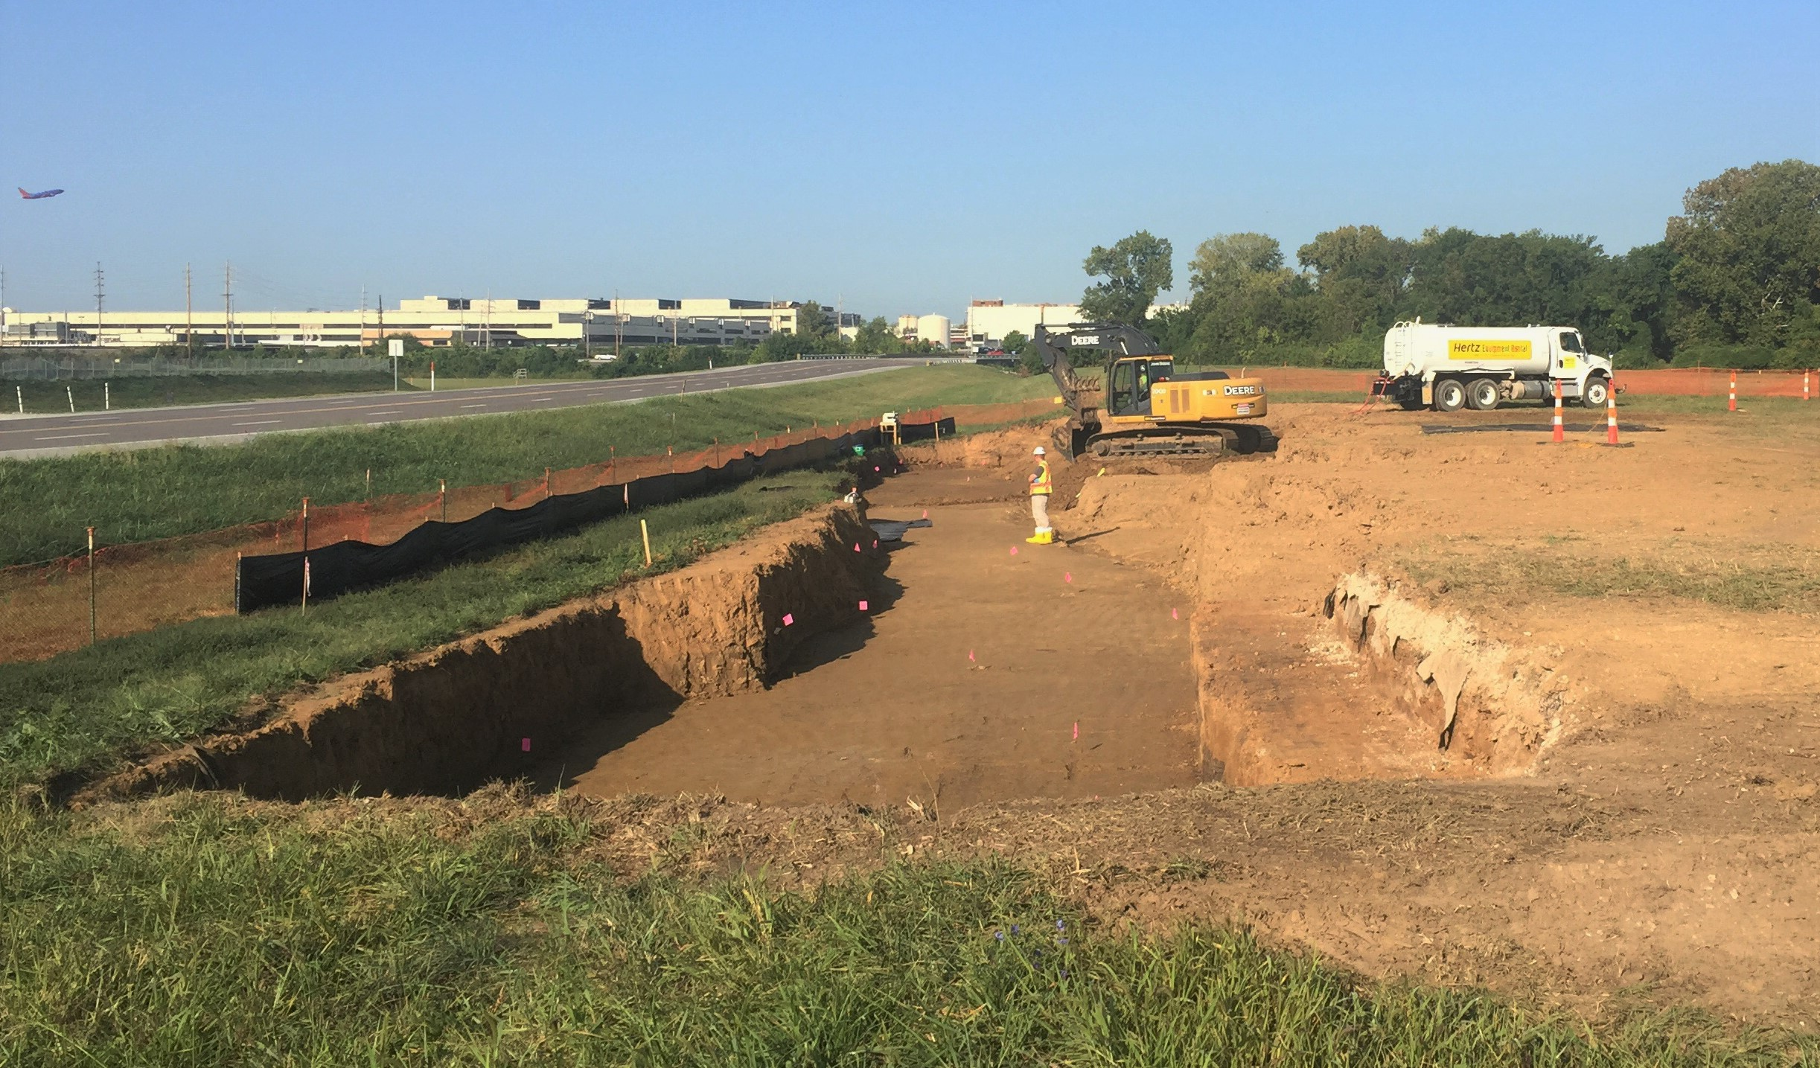
North County Continued Progress at Residential and Industrial Properties
Excavation and verification sampling at residential properties
Excavation and loading sampling at “former Ballfields”
Notes:
St. Cin: weather permitting parking lot will be repaved tomorrow
Duchesne Park has a north and south site; north site is complete and property will soon be returned for Beneficial Use.
COCs being found at depths up to 4-8 ft.
Current estimate is 50% - 60% complete.
Next sites:
1. desire to do Palm Drive Props next; dependent on timing of when utility work is done;
2. Archdiocese next if follow-on bounding work is completed timely
3. Third option is to move to Ballfields
Desire to open multiple sites: funding and sampling dependent

Slide 5
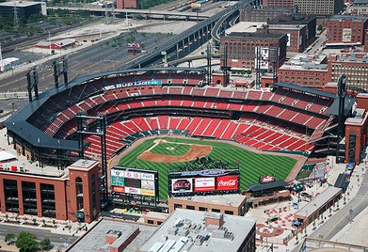
A Ballpark Number!
Since 1997, St. Louis District, USACE, FUSRAP has disposed more than 1.3 million cubic yards of contaminated soil.
That’s enough to fill Busch Stadium nearly 1 ½ times from grass to rooftop!!!
Notes:
Will discuss more a little later, but:
SLAPS and HISS are source locations: already complete so shows 0 CY
Latty Properties deferred while we focus on CWC properties; Includes the HISS source site which is already cleaned up
IAAAP will actually process close to 13,000 CY to get 1,300 CY shipping

Slide 6
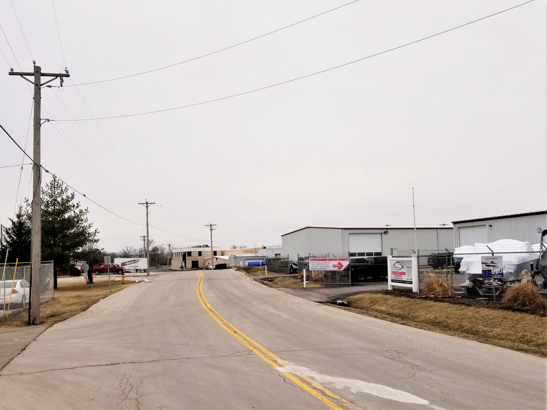
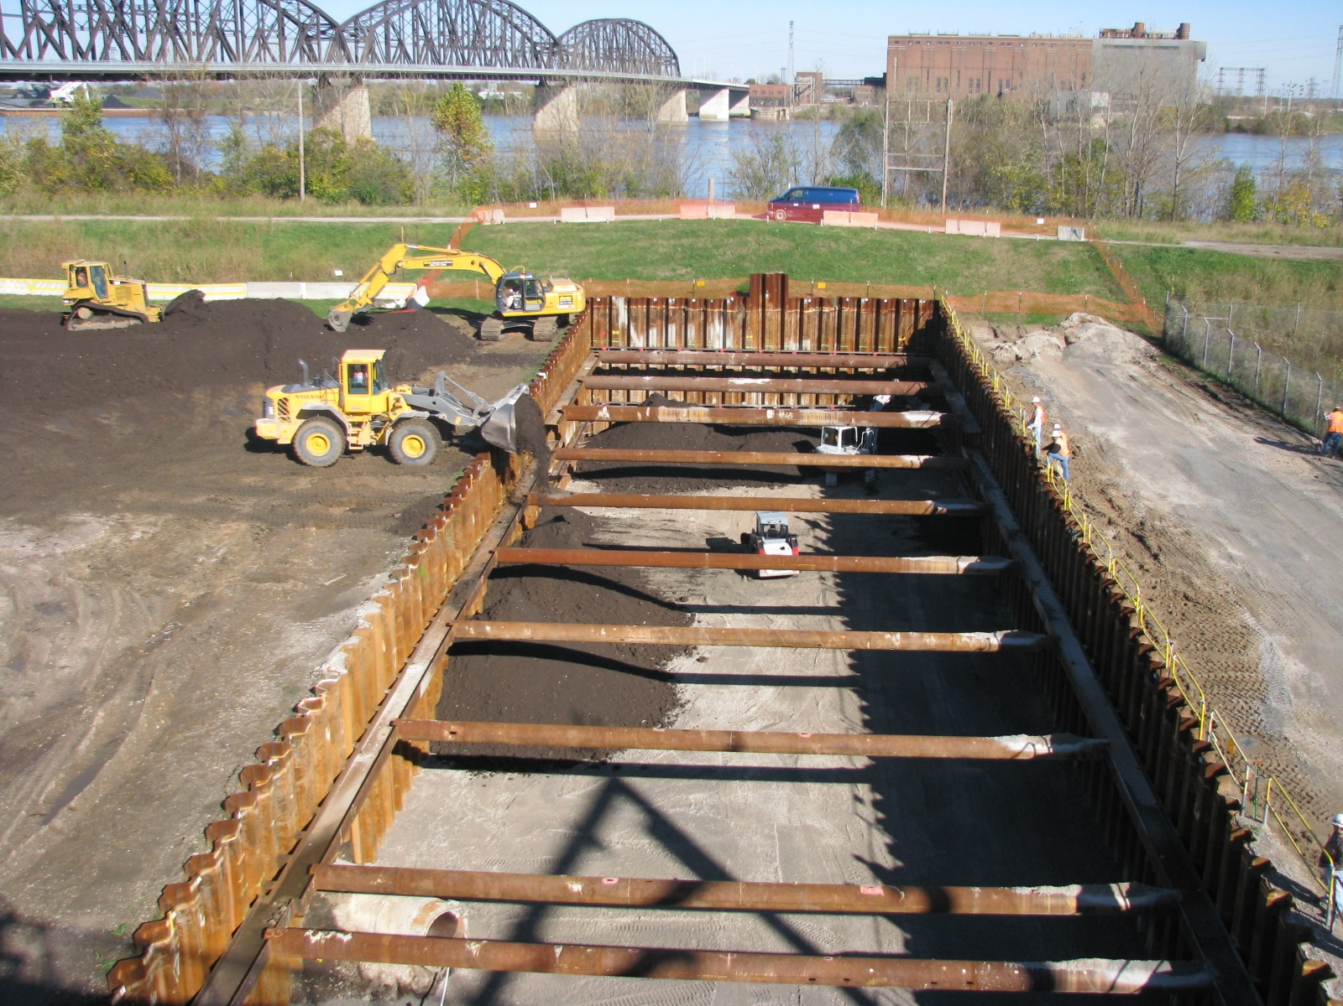
Properties Released for Beneficial Use
(2018 & 2019)
North St. Louis County Sites:
Properties released in 2018: 60
Properties released to date: 182
Properties planned for 2019: 40
St. Louis Downtown Site:
Properties released in 2018: 3
Properties released to date: 47
Properties planned for 2019: 3
Notes:
St. Cin: weather permitting parking lot will be repaved tomorrow
Duchesne Park has a north and south site; north site is complete and property will soon be returned for Beneficial Use.
COCs being found at depths up to 4-8 ft.
Current estimate is 50% - 60% complete.
Next sites:
1. desire to do Palm Drive Props next; dependent on timing of when utility work is done;
2. Archdiocese next if follow-on bounding work is completed timely
3. Third option is to move to Ballfields
Desire to open multiple sites: funding and sampling dependent

Slide 7
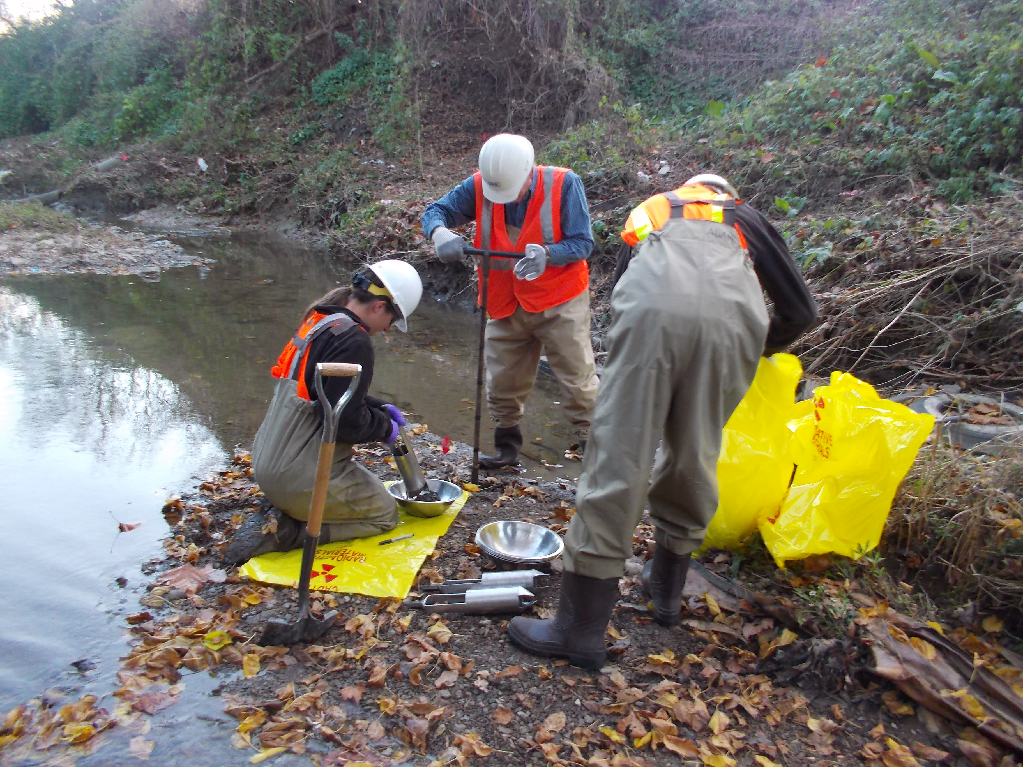
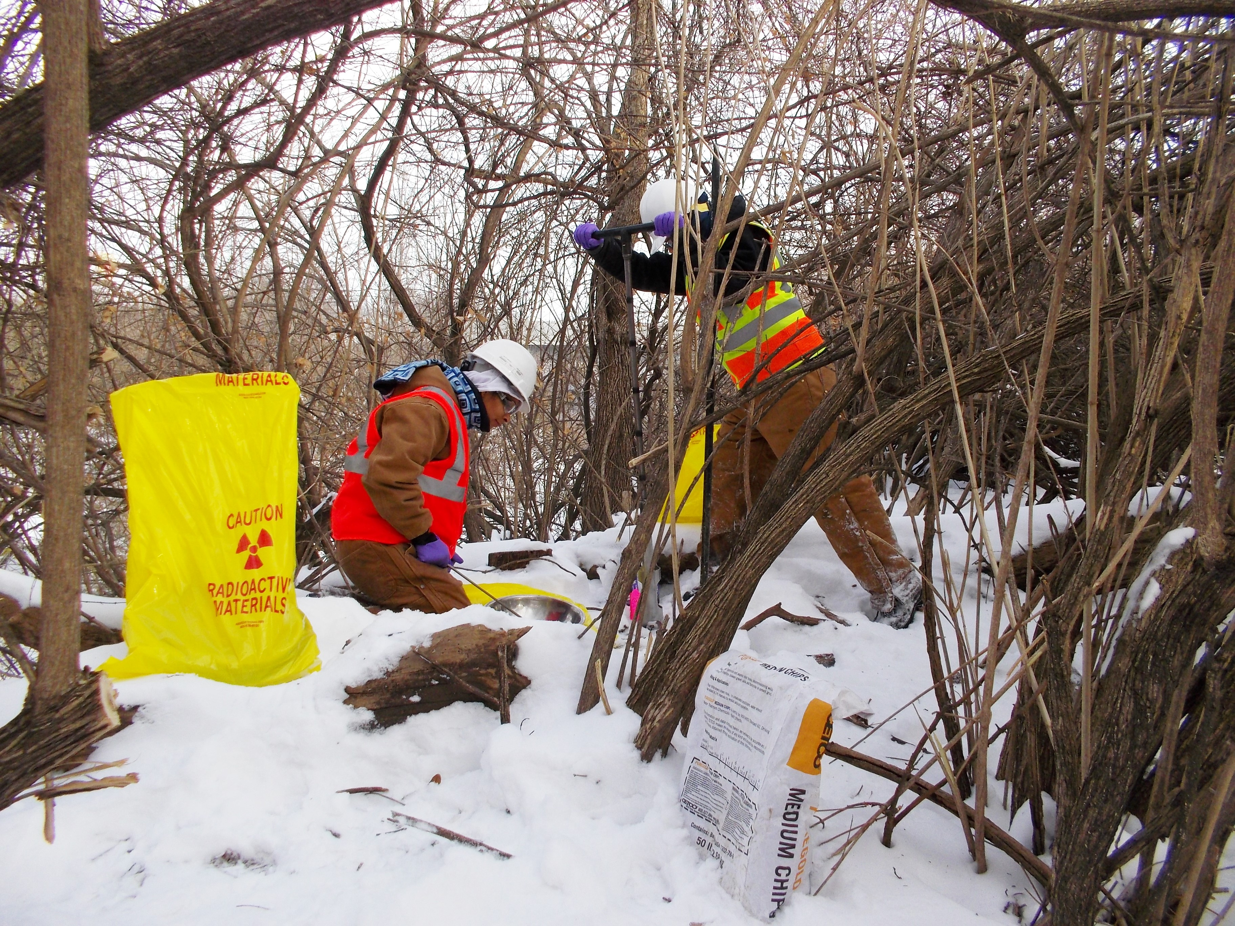
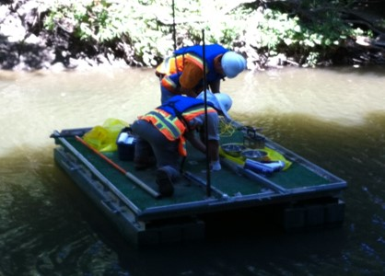
Sampling Coldwater Creek
In addition to a dense grid, sampling locations are
based on current & historical knowledge, such as
Physical movement of soil (hauling, grading)
Low-lying areas where pooling could occur
Depositional areas in creek (bends, near objects)
Mouths of tributaries
Realigned channels
USACE takes samples at depths that
are appropriate for that location.
Example: Samples at locations for
historic tributaries (now filled)
will extend to the depth of the
former channel.
Notes:
Follow-on sampling for final characterization, bounding, and design was slowed when need for remediation in residential and recreational use areas became known.
Prioritization of properties will be discussed a bit later.
Approximately 10% of samples with SOR>1
* Many of those in areas already remediated
* Others at locations to be looked at in greater detail (yellow area on preceding map); possibly additional sampling required
Not every location with a SOR>1 will necessarily require remediation

Slide 8
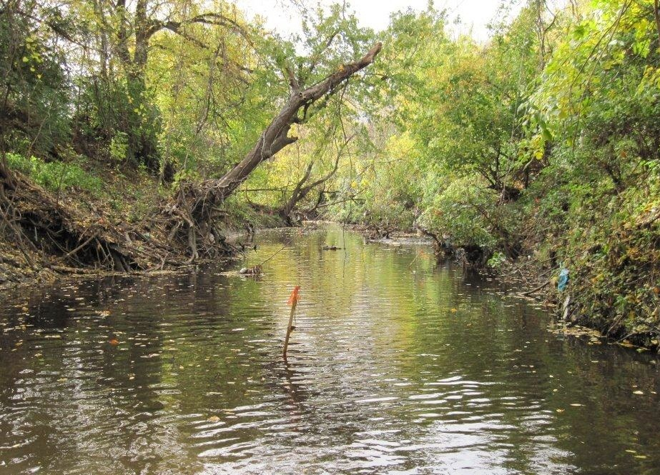
Sampling Coldwater Creek – All 4 Seasons Floodplain Soil and Creek Sediment
Notes:
Follow-on sampling for final characterization, bounding, and design was slowed when need for remediation in residential and recreational use areas became known.
Prioritization of properties will be discussed a bit later.
Approximately 10% of samples with SOR>1
* Many of those in areas already remediated
* Others at locations to be looked at in greater detail (yellow area on preceding map); possibly additional sampling required
Not every location with a SOR>1 will necessarily require remediation

Slide 9
2019 Coldwater Creek
Sampling Plan
New Halls Ferry Road
Sampling in 2019 will be primarily on properties between St. Denis Bridge and New Halls Ferry Road.
Not all properties will be sampled in 2019.
Currently sampling in GOLD area.
St. Denis Bridge
Notes:
Follow-on sampling for final characterization, bounding, and design was slowed when need for remediation in residential and recreational use areas became known.
Prioritization of properties will be discussed a bit later.
Approximately 10% of samples with SOR>1
* Many of those in areas already remediated
* Others at locations to be looked at in greater detail (yellow area on preceding map); possibly additional sampling required
Not every location with a SOR>1 will necessarily require remediation

Slide 10
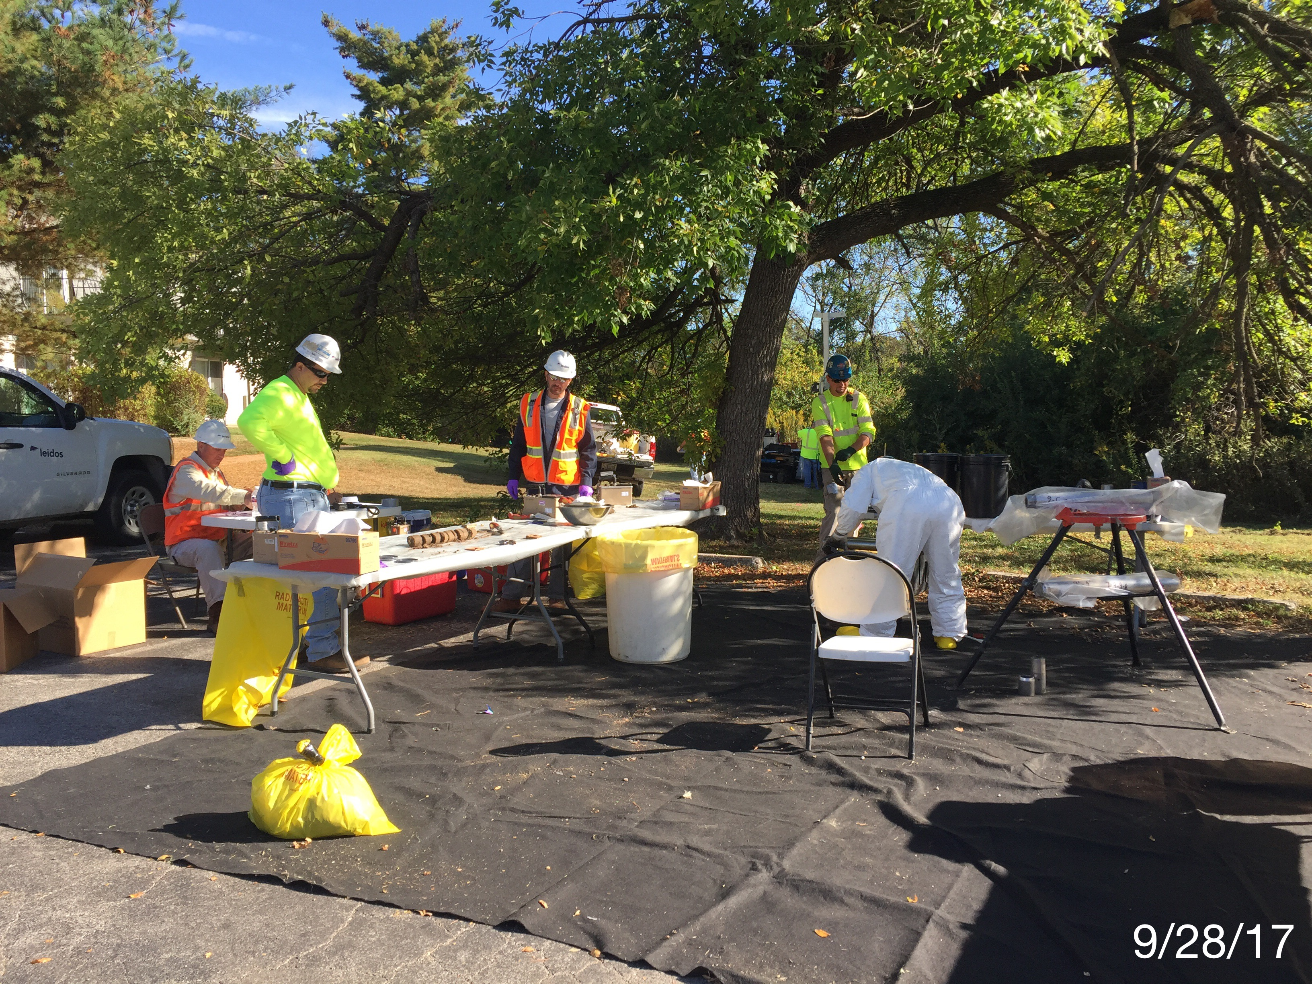
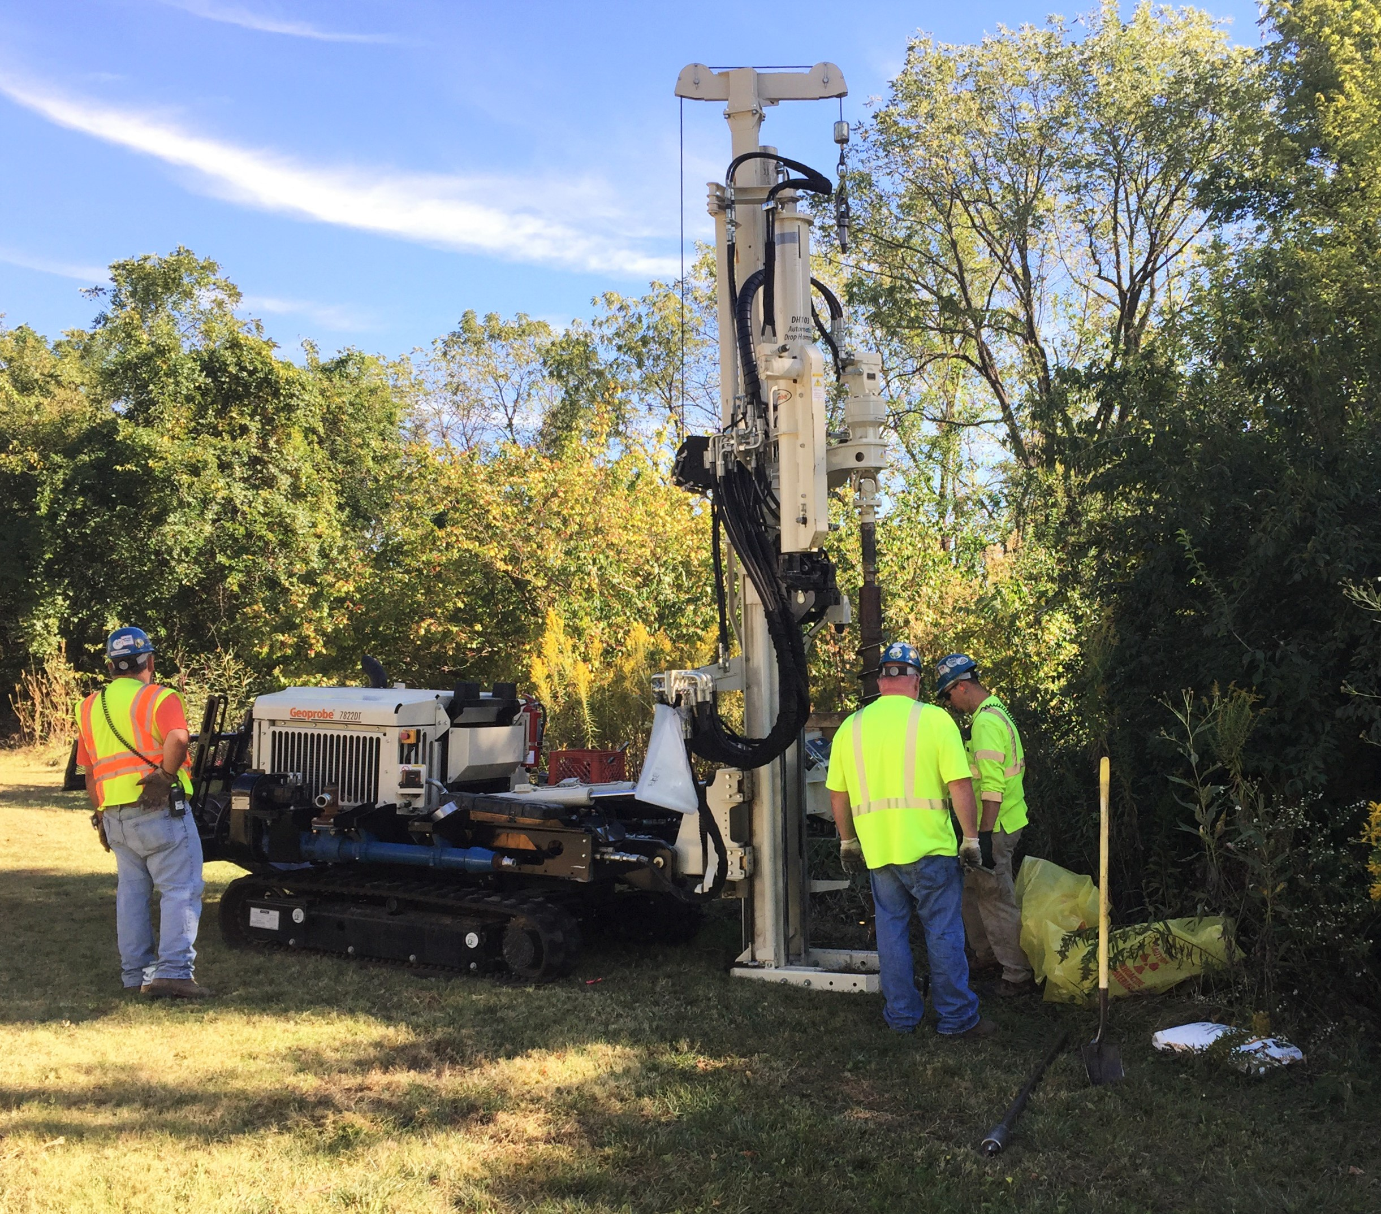
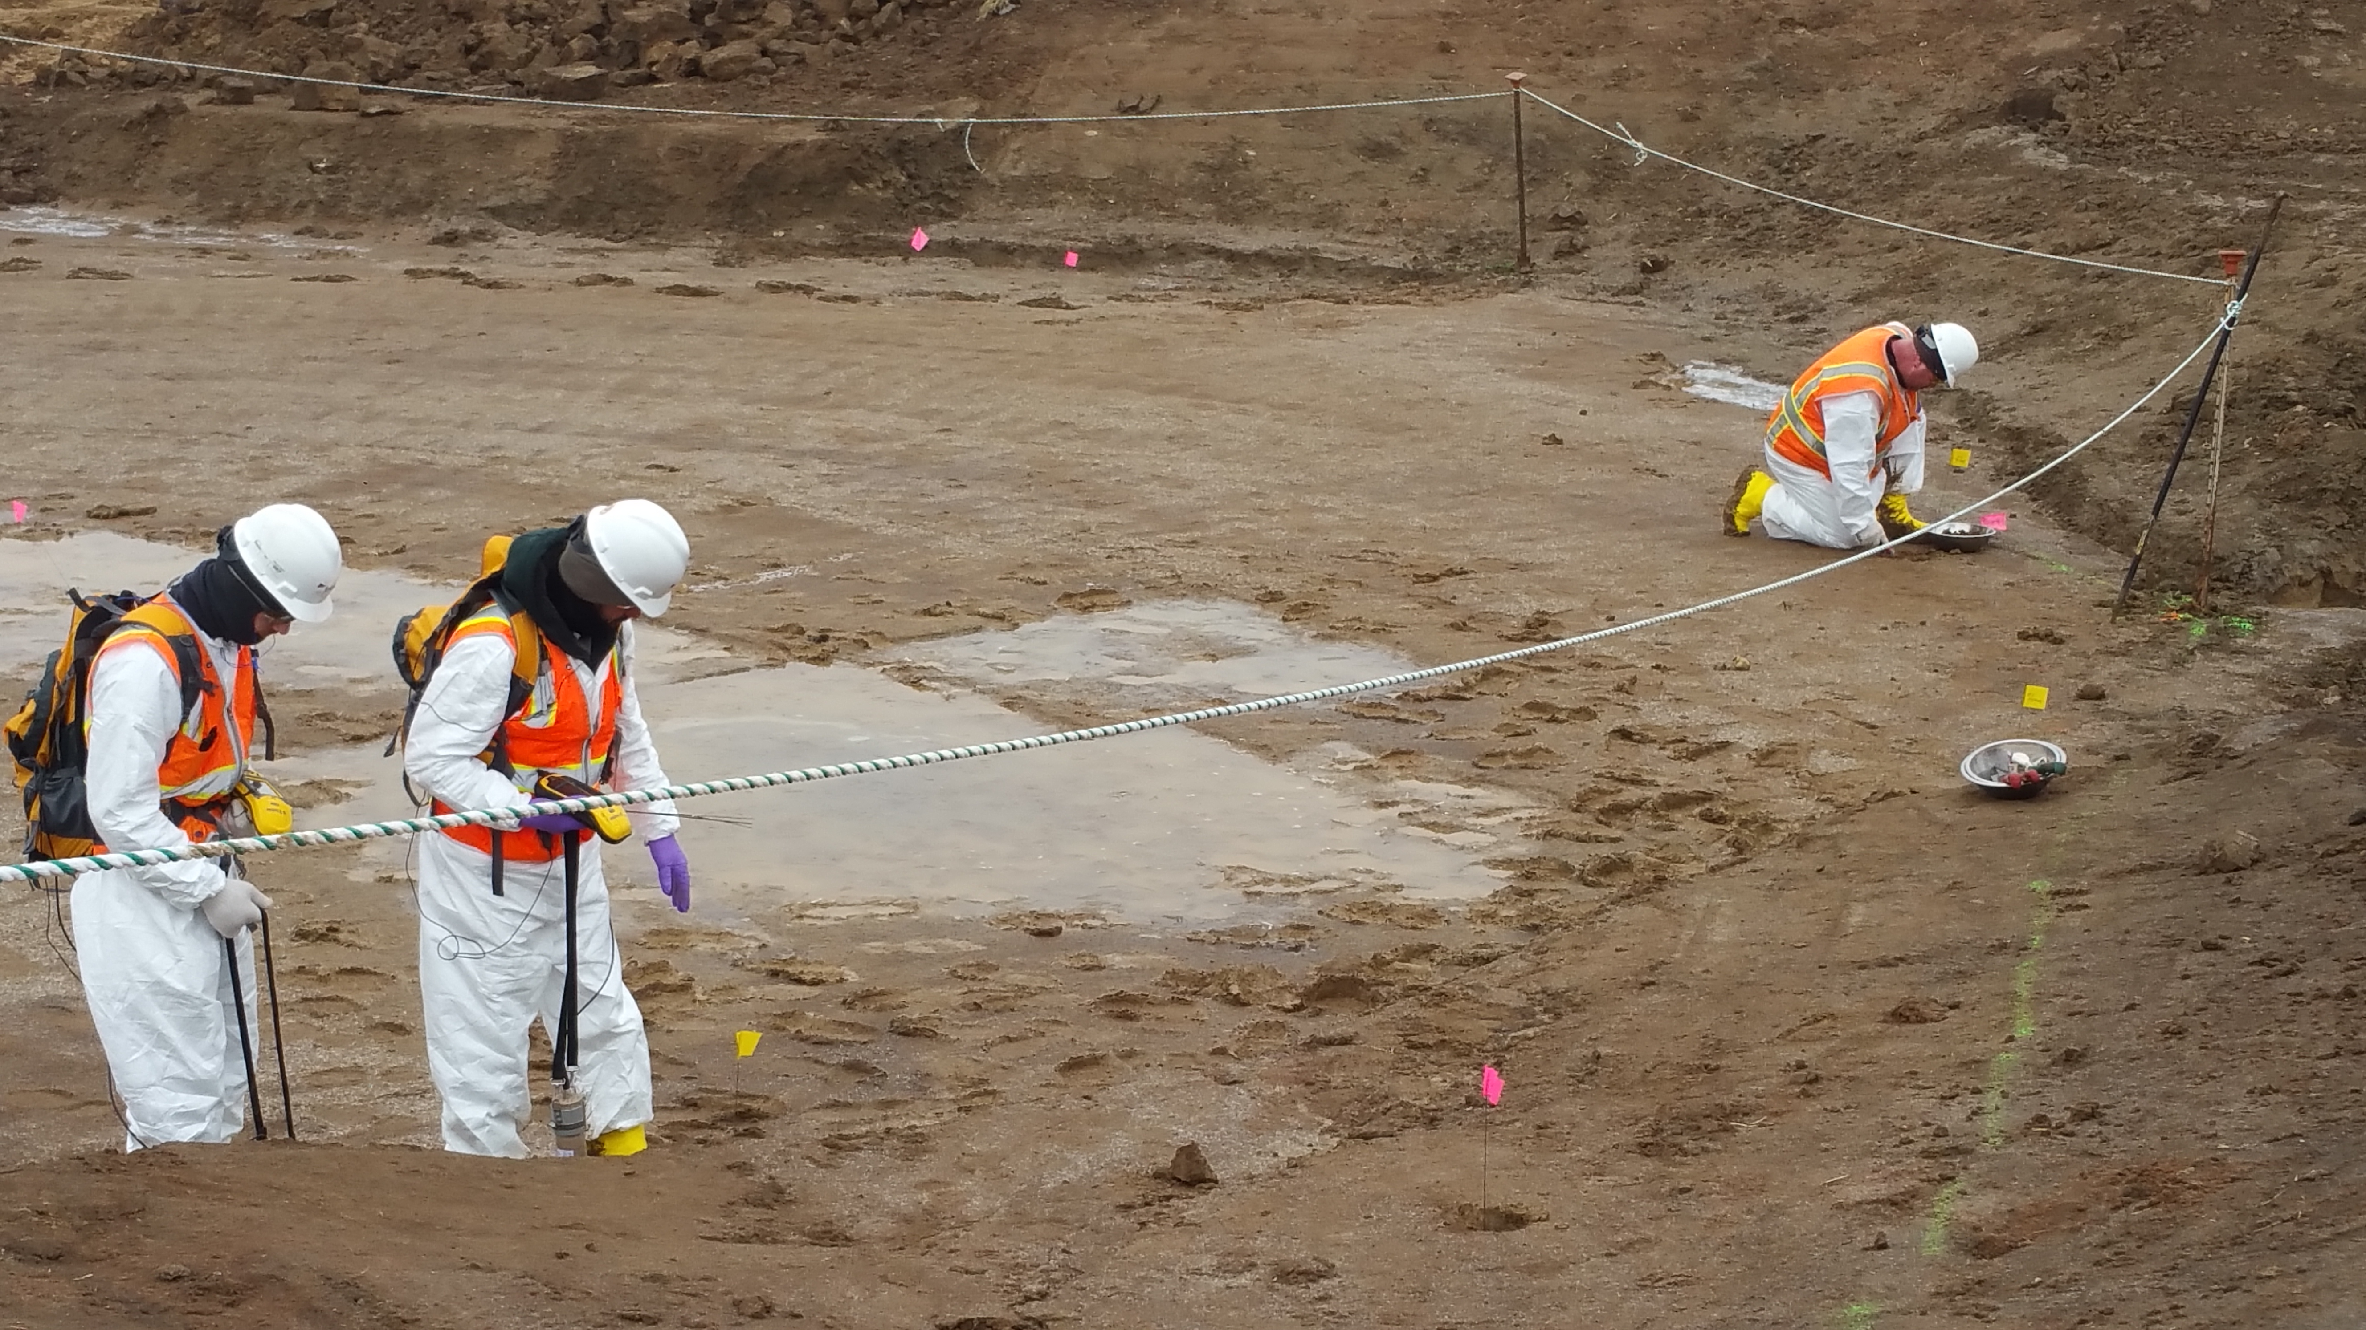
Searching the Floodplain for Contamination At the Surface, At Depth, After Excavation
Notes:
Follow-on sampling for final characterization, bounding, and design was slowed when need for remediation in residential and recreational use areas became known.
Prioritization of properties will be discussed a bit later.
Approximately 10% of samples with SOR>1
* Many of those in areas already remediated
* Others at locations to be looked at in greater detail (yellow area on preceding map); possibly additional sampling required
Not every location with a SOR>1 will necessarily require remediation

Slide 11
Amazing Safety Record
Field Sampling and Laboratory Analysis Contractors:
Over 19 years since 1999
Worked more than 1.4 million man-hours to date
Only 1 Lost Time Accident.
Remedial Action Contractors:
Began at SLDS and SLAPS in 1998
Amassed nearly 4 million man-hours of effort
Only 4 Lost Time Accidents.
Notes:
Will discuss more a little later, but:
SLAPS and HISS are source locations: already complete so shows 0 CY
Latty Properties deferred while we focus on CWC properties; Includes the HISS source site which is already cleaned up
IAAAP will actually process close to 13,000 CY to get 1,300 CY shipping

Slide 12
Contact Information
Website
FUSRAP Website http://bit.ly/FUSRAPstl
St. Louis District Website https://www.mvs.usace.army.mil/
E-mail
STLFUSRAP@usace.army.mil
General Information
FUSRAP Office 314-260-3905
Public Affairs Office 314-331-8000
Newsletter
Biannual; sign-up list at Welcome Table
Administrative Record
Documents are available for viewing at:
FUSRAP Office, 8945 Latty Ave., Berkeley, MO (314-260-3905)
Hours: Weekdays from 8 a.m. to 3 p.m. – by appointment
St. Louis Public Library, 1301 Olive Street, St. Louis, MO
[314-241-2288 – Ask for the History Room
(by appointment only)]

Slide 13
Questions?
Shipping and Disposal
St. Louis Downtown Site Table
North County Sites Table
Transportation and Disposal Table
Downtown Remediation
St. Louis Downtown Site Table
North County Progress
North County Sites Table
Properties Released
St. Louis Downtown Site Table
North County Sites Table
Coldwater Creek Table
Sampling in Coldwater Creek
Coldwater Creek Table
Environmental Monitoring Table
Safety Record
Transportation and Disposal Table
Contact Information
Welcome Table

